Slide 1
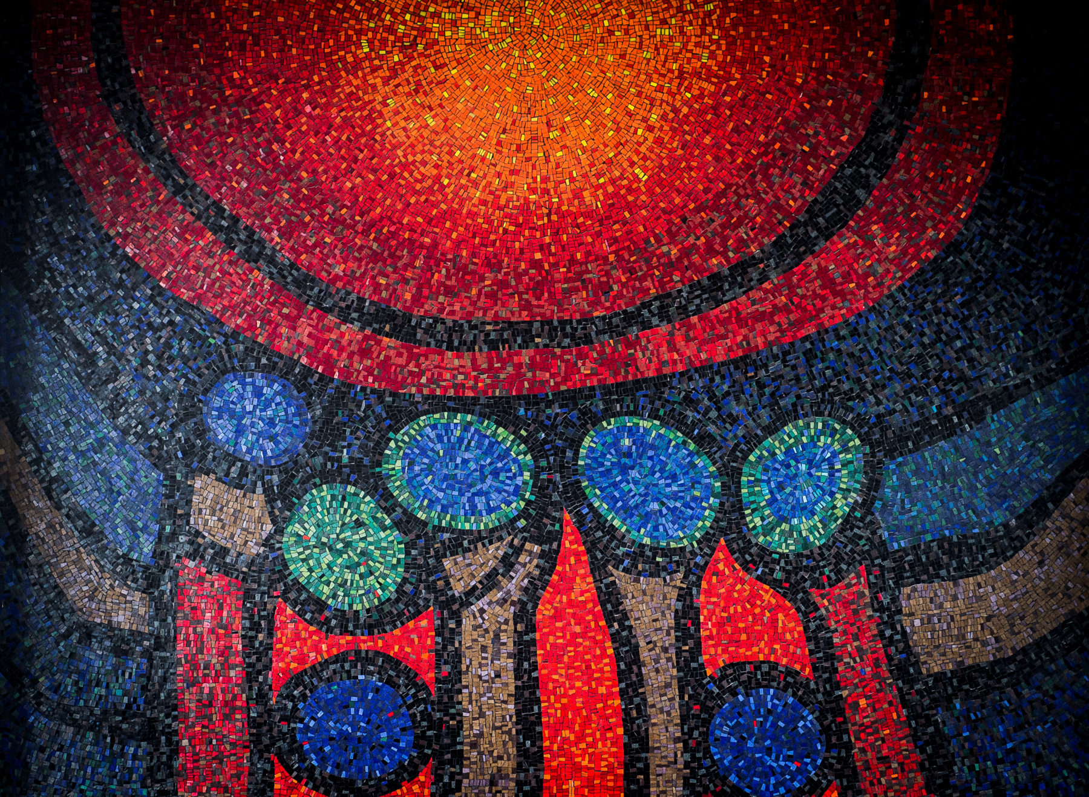

Optical Coherence Tomography: Prediction of Progression of Diabetic Retinopathy Severity Through Machine Learning
Cyrus WaChong
BASc Thesis Defense
March 29th, 2021
Engineering Science
Notes:
(Thank you, Professor Sarunic, for the introduction).
Good afternoon everyone, thank you for attending my defense, I’m glad to be able to see you all again. My name is Cyrus WaChong, and my presentation is on the application of Optical Coherence Tomography (or OCT) for the prediction of progression of Diabetic Retinopathy severity using machine learning as Professor Sarunic mentioned.

Slide 2
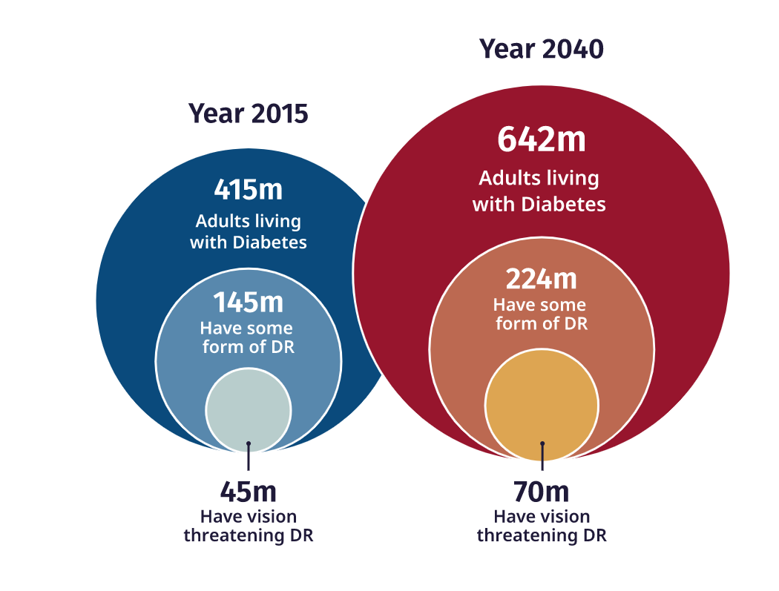
Diabetic Retinopathy
Epidemiology
Leading cause of blindness amongst working-age adults¹
Extremely common in diabetic patients (~35%)
Diabetes is an epidemic expected to affect 642 million people globally by 2040²
1. The worldwide epidemic of diabetic retinopathy.
Zheng, Y., He, M., & Congdon, N. (2012). Indian journal of ophthalmology, 60(5), 428.
2. IDF Diabetes Atlas: Global estimates for the prevalence of diabetes for 2015 and 2040. Ogurtsova, K., da Rocha Fernandes, J. D., Huang, Y., Linnenkamp, U., Guariguata, L., Cho, N. H., ... & Makaroff, L. E. (2017). Diabetes research and clinical practice,128, 40-50.
Notes:
Diabetic retinopathy, or DR for short, is an eye condition that is a common complication of diabetes. It is ranked as the fifth most common cause of preventable blindness yet is a leading cause of blindness amongst working-age adults.
The large circles in the figure represent the population with diabetes, while the mid sized circle represents the subset of those people with some form of diabetic retinopathy
With diabetes expected to affect 642 million people globally by 2040, compared to the 415 million in 2015, diabetic retinopathy is one of many complications expected to increase the already large burden on the healthcare system in the near future.

Slide 3
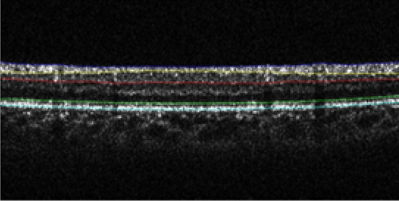
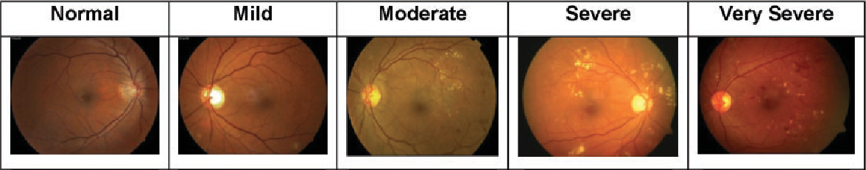
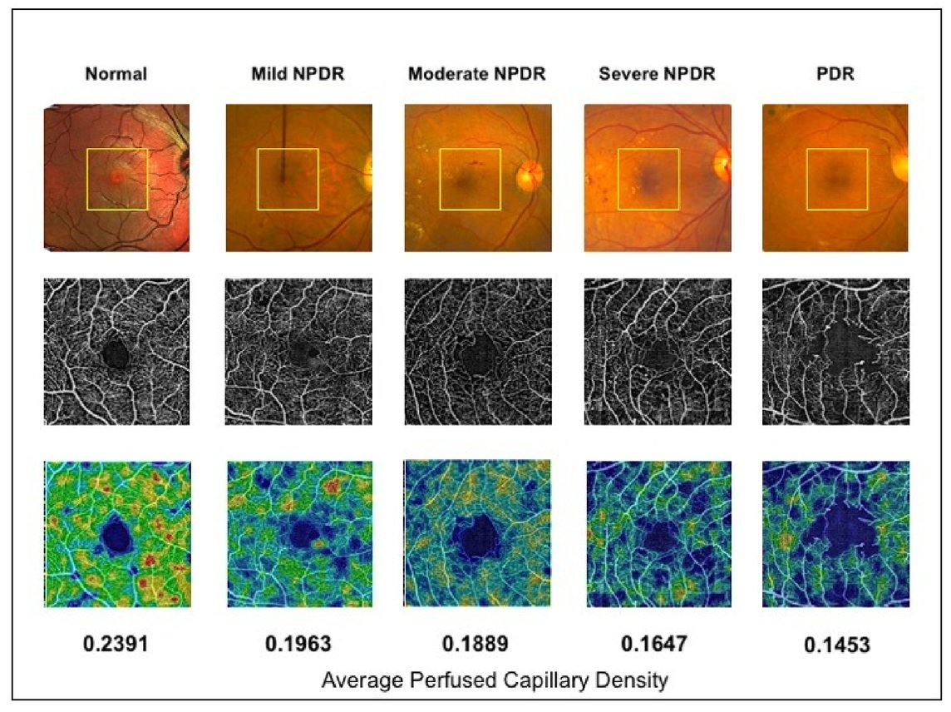
Image Acquisition for Diabetic Retinopathy
Diabetic Retinopathy Severities
Five stages – normal, mild, moderate, severe, and proliferative DR
Three stages – normal, non-proliferative DR, PDR
Two stages – non-referable and referable DR
Fundus Imaging
Camera -> 2D reflective properties
OCT Volumes
Cross-sectional retinal information (B-scan)
OCTA En Face Images
Images the capillary-vessel microcirculation
Notes:
There are many scales used for categorization of DR severity. Commonly, clinicians categorize DR into 5 stages: normal, mild, moderate, severe, and proliferative DR.
This can be further categorized into 3 stages, namely: normal, Non-proliferative DR, and PDR, as well as a binary classification of referable or non-referable DR.
(note) NPDR encompasses mild, moderate, and severe DR; Referable is more than mild NPDR, or any DR with diabetic macular edema (build up of fluid in the macula, which distorts vision)
The stages of DR are represented in these fundus images. Fundus photography images the surface of the retina by flashing a bright light, then acquiring colour images of the interior surface of the eye using a camera.
[*] OCT data is acquired in the form of a 3D volume. This data is commonly viewed in slices also known as a B-scan, an example of which is seen here, providing cross sectional retinal information.
(note) Hyporeflective layers forward-scattering light, hyperreflective layers backscattering light
[*] These are OCT Angiography en face images of different severities of diabetic retinopathy. As the disease becomes more severe, you will see an enlargement of the region near the center without vessels known as the foveal avascular zone, or FAZ for short. You can also expect to see changes in vessel density, along with other features that I’ve described in detail in the written document. OCTA En Face Scans are an extension of OCT that photographs the perfusion in the vessels at different depths without the use of injectable dyes.
(note) OCTA data is extracted by comparing sequentially acquired B-scans to visualize retinal blood flow.

Slide 4
DR Classification Tools in the Literature
Utilizing Fundus Images
Readily available open source clinically diagnosed eyes
Literature – specificity/sensitivity of 93.4%/97.5%^{[3]} and 96%/95%^{[4]} in RDR identification
Literature – specificity/sensitivity of 77%/66%^{[5]} in DR progression classification
Utilizing OCTA Images
Limited dataset size
New in comparison to fundus-based neural networks
Literature – specificity/sensitivity of 93.3%/90.4%^{[6]} in referable DR classification
3. Development and validation of a deep learning algorithm for detection of diabetic retinopathy in retinal fundus photographs.
Gulshan, V., Peng, L., Coram, M., Stumpe, M. C., Wu, D., Narayanaswamy, A., ... & Webster, D. R. (2016). Jama, 316(22), 2402-2410.
4. Diabetic Retinopathy detection through integration of Deep Learning classification framework.
Rakhlin, A. (2018). bioRxiv, 225508.
5. Deep learning algorithm predicts diabetic retinopathy progression in individual patients.
F. Arcadu, F. Benmansour, A. Maunz, J. Willis, Z. Haskova., & M. Prunotto (2019). NPJ digital medicine, 2(1), 1-9.
6. Ensemble deep learning for diabetic retinopathy detection using optical coherence tomography angiography.
Heisler, M., Karst, S., Lo, J., Mammo, Z., Yu, T., Warner, S., ... & Sarunic, M. V. (2020). Translational Vision Science & Technology, 9(2), 20-20.
Notes:
With the number of diabetic retinopathy cases expected to steadily increase, secondary to diabetes, there is a need to provide clinicians with tools in managing the disease efficiently and accurately.
As a result, many are turning towards machine learning through classification tools.
Many studies have trained neural networks for referable DR classification using fundus images due to their availability and have achieved high accuracies.
Related to this project, one group recently trained a neural network to predict the progression of DR using fundus images, achieving a specificity and sensitivity of 77 and 66 percent, respectively.
[*] In comparison to projects using fundus images, OCTA data is limited, and DR progression results are sparse. Using OCTA en face scans, a study conducted by Dr. Morgan Heisler and the BORG classified referable DR with an accuracy of approximately 92%.
My thesis studied DNN powered prediction of DR progression using OCTA en face images. Although there have been studies using OCTA images for DR classification, there has yet to be any published studies using OCTA images to train DNN’s for DR prognostication.

Slide 5
Thesis Scope
Purpose
Investigating deep learning tools to assist clinicians for prognosticating DR
Goal: Accuracy of greater than 75%
Compare parameter-based versus image-based progression classification
Scope
Studied the performance of DR prognostication with different:
OCT and OCTA en face plexuses
Neural network implementations
Notes:
The purpose of this thesis was to investigate the usage of machine learning on OCT and OCTA data to assist clinicians in DR prognostication. I created a self-imposed goal of achieving an accuracy of 75% by studying the results of literature and taking into consideration the limitations.
The performance of parameter-based and image-based methods for prediction of DR progression will be compared, along with the effect of using different OCT and OCTA plexuses, and different neural network implementations
(note) Low- and middle-income countries account for approximately 75% of the global diabetes burden, yet many are ill-equipped to properly identify, treat and manage this disease.

Slide 6
Dataset and Machine Learning Applications
Unaltered dataset used
205 “No Progression” (164 training, 41 validation)
32 “Progression” (25 training, 7 validation)
OCTA of the Superficial Capillary Plexus (SCP) and Deep Capillary Plexus (DCP) provided for each eye
Binary ground truth corresponding to DR progression of the eye
Two machine learning methods tested
Feature-based method: Using extracted parameters correlated to DR progression for training
Image-based approach: Using 3-Channel images for training
Notes:
The group at the Chinese University of Hong Kong provided us with a dataset of 237 eyes, 205 of which did not experience DR progression, and 32 which did experience DR progression. The OCTA en face image for the Superficial capillary plexus and deep capillary plexus were provided for each of these eyes. 80% of the dataset was used for training, while 20% was used for validation.
Along with these images, a binary ground truth was provided, which corresponded to whether the eye experienced DR progression.
(note) CUHK used the Airlie House classification system, which provided a 15-step DR severity scale. Progression was defined as an increase in 2 or more steps of severity level compared to the baseline
As mentioned in the previous slide, two separate machine learning methods were tested during this thesis:
The first of which is a feature-based method, which uses a neural network trained on extracted features that are found to be correlated to DR progression, and
an Image based approach, which uses a 3-channel input image for training, which will be explained in a few slides.

Slide 7
Feature-based Network
Single hidden layer feedforward neural network used for training
Composed of one input layer, one hidden layer, and one output layer
Seven correlated parameters were found, similar to the findings in the CUHK publication
Fractal dimension (4 regions)
Max FAZ Diameter
FAZ Area
FAZ Perimeter
Progression
No Progression
Notes:
For the feature based approach, a single hidden layer feedforward network was used, which is simply a neural network composed of an input layer which feeds into a hidden layer, and finally an output layer.
Using the feature extraction pipeline developed by our group, we were able to find 7 parameters correlated to the progression of DR.

Slide 8
Feature-based Network: Results
Varying number of input features were tested
Every test overfit to the larger class
Larger class (no DR progression) made up 85.4% of validation set
3 inputs provided lowest validation loss
Metrics
 | Validation Accuracy | Specificity | Sensitivity | Validation Loss
7 | 85.4 | 1 | 0 | 0.3931
6 | 85.4 | 1 | 0 | 0.4407
5 | 85.4 | 1 | 0 | 0.4054
4 | 85.4 | 1 | 0 | 0.3971
3 | 85.4 | 1 | 0 | 0.3926
2 | 85.4 | 1 | 0 | 0.4002
1 | 85.4 | 1 | 0 | 0.4003
Number of Parameters Inputted
Notes:
Due to the limited size of the dataset, dimensionality became an issue. The more features that are used for training, the more data that’s required for reliable results. For this reason, different numbers of input features were tested.
[*] Unfortunately, every test done for the feature-based method resulted in a network that fully overfit to the larger class, meaning that the network predicted the same value for every input, or in this case that every eye would experience no DR progression.
This is proven by the specificity being 1, and sensitivity being 0, along with the validation accuracy being the same as the percent composition of the larger class in the validation set.
[*] Using 3 features as the input provided a network with the lowest validation loss. The next method to predict the progression of DR is to use OCT and OCTA images as direct inputs, which will be called the image-based approach.

Slide 9
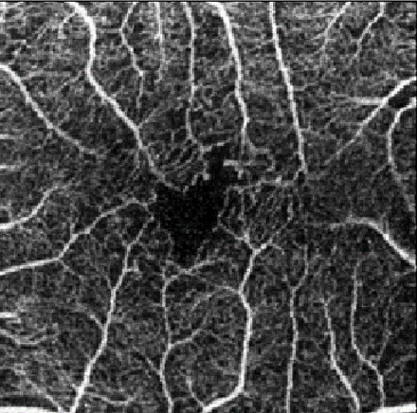
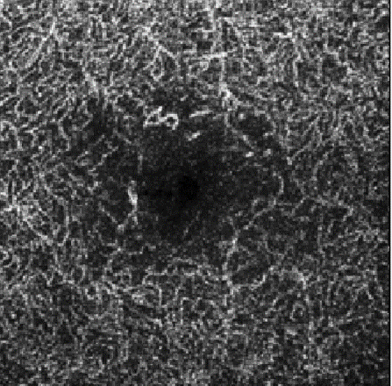
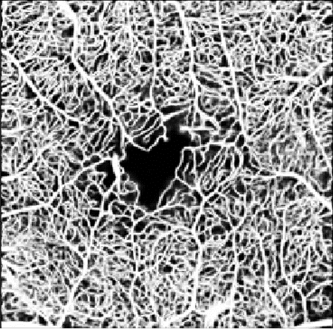
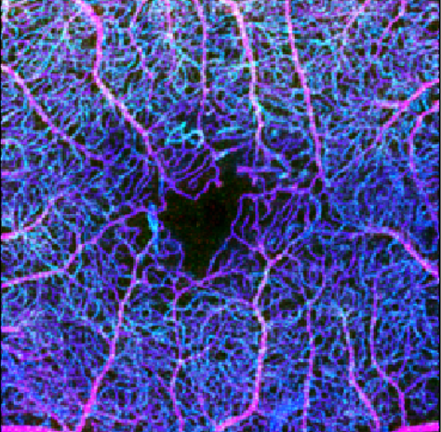
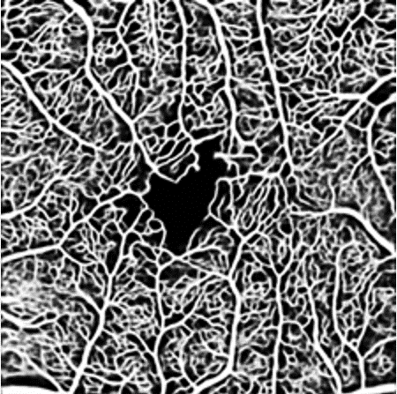
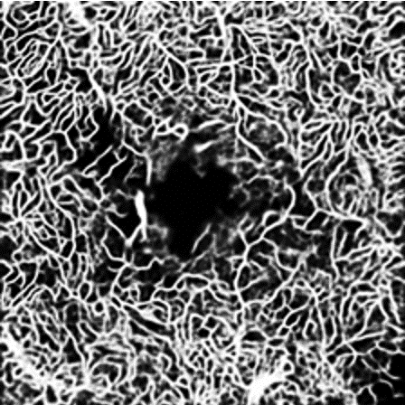
Image-based Network: Input
SCP Angio
DCP Angio
MIP Segmentation
Neural network input
OCTA SCP Seg.
OCTA DCP Seg.
Notes:
Here we can see a visual representation of a 3-channel image that will be used as input into the network, and how it is created.
3 channel images are quite common for convolutional neural networks, and were used for this project to allow for easy DNN implementation that will be covered in later slides.
The segmentations were created using our groups vessel segmentation pipeline, which were then used to compute the Maximum Intensity Projection image,
which is the process of choosing the highest pixel intensity for every pixel in all image being MIP’ed, and using that as the pixel value in the MIP.
(note) This provides information on the vasculature more easily, as the vasculature is more pronounced.
The final input image is created using the OCTA of the SCP as the first channel, the OCTA of the DCP as the second channel, and the MIP of the segmentations as the third channel.
An example of a 3-channel input image can be seen on the right

Slide 10
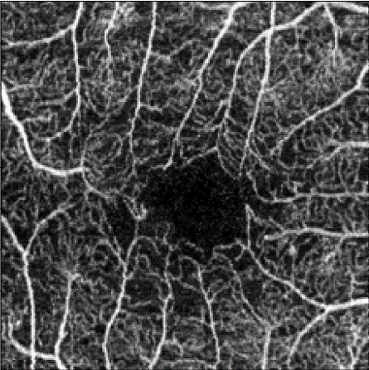
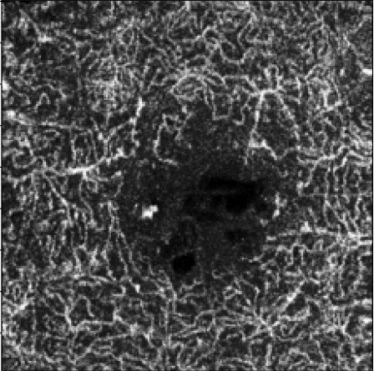
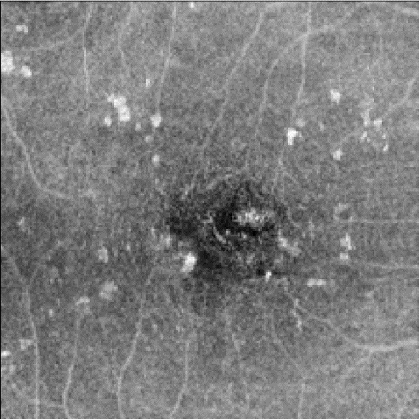
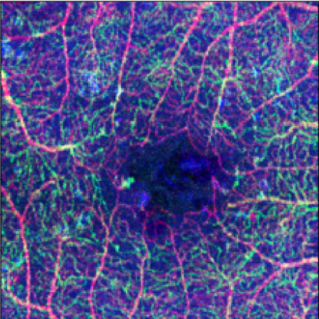
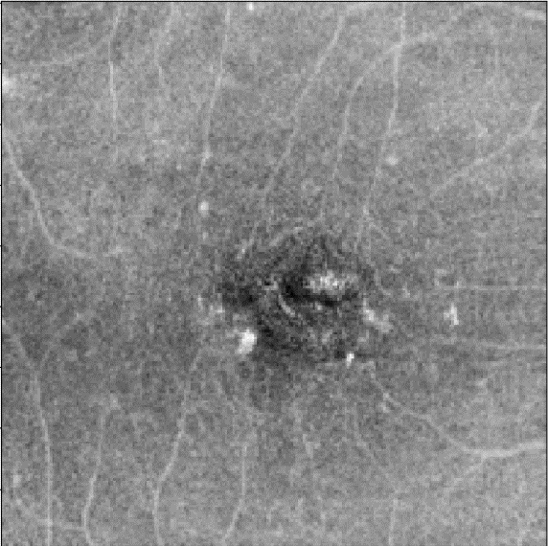
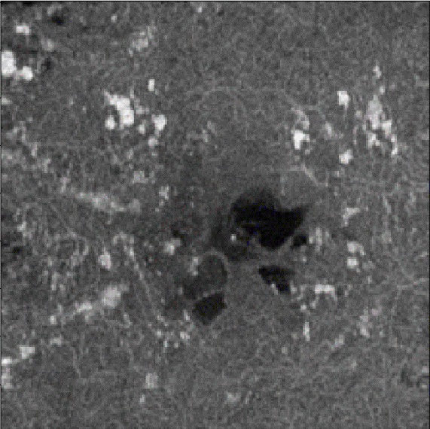
Using Structural OCT Images
SCP Angio
DCP Angio
MIP Structural
Neural network input
SCP Structural
DCP Structural
Notes:
Once structural OCT images were provided, they were tested in place of the segmentations in the third channel.
These structural images could provide more information to the network, including structural changes caused by DR, which may help the network detect features related to DR progression.

Slide 11
Methods Explored
Down-sampling
Decreasing size of larger class to match smaller class
Data Augmentation
Up-sample smaller class to size of larger class with image transformations
Rotations, reflections, contrast scaling
Transfer Learning
Weights of previously trained neural networks to initialize current network
Used weights from ImageNet network and DR classification network
Notes:
Three main methods were tested for their effects on overall performance.
Down-sampling was our first attempt to tackle the issue of an imbalanced dataset. The larger class, in this case the class containing images that did not convert, was down sampled to match the size of the class of images that did convert.
Our second attempt to minimize the effects of an imbalanced dataset was to implement data augmentation, which up samples the smaller dataset by applying transformations, such as rotations, reflections, and contrast scaling.
The third method was used to provide a better starting point for the neural network. Transfer learning involves initializing the network weights with the weights of a network that has been previously trained for a different classification problem.
We tested with both ImageNet weights, and with weights of a network used for DR classification.

Slide 12
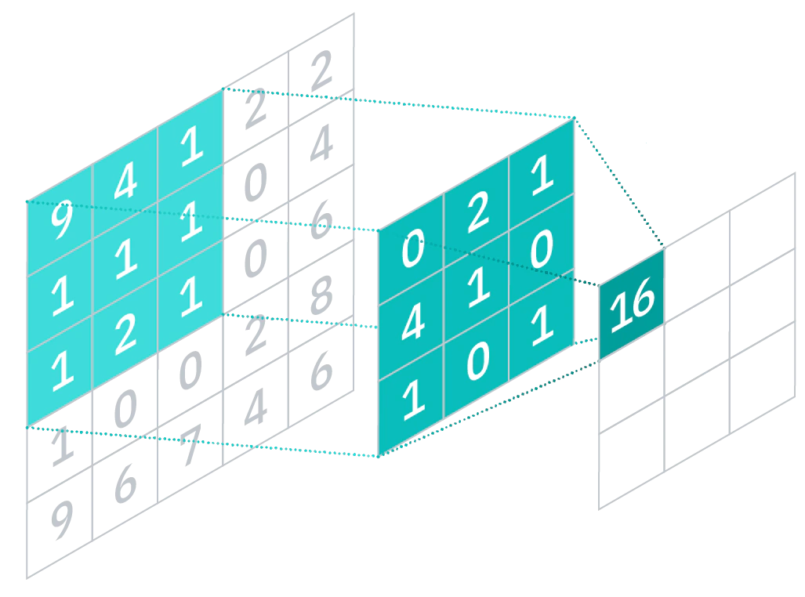
Convolutional Neural Networks
Image-based approach uses Convolutional Neural Network (CNN)
CNN’s use trainable kernels (sliding windows)
Able to detect features in images
2-D convolutions performed with kernels
Done using matrix multiplication with input and kernel
Notes:
For the image-based approach for prediction of DR progression, a convolutional neural network will be used
CNN’s use kernels, which are sliding windows with trainable coefficients, to detect features in images, in this case features related to DR progression in OCTA en face images.
Each kernel is responsible for detecting a certain feature, and this kernel will slide across the image detecting whether the feature is present in its current position
2-D convolutions are performed using matrix multiplication between the input and the kernels.

Slide 13
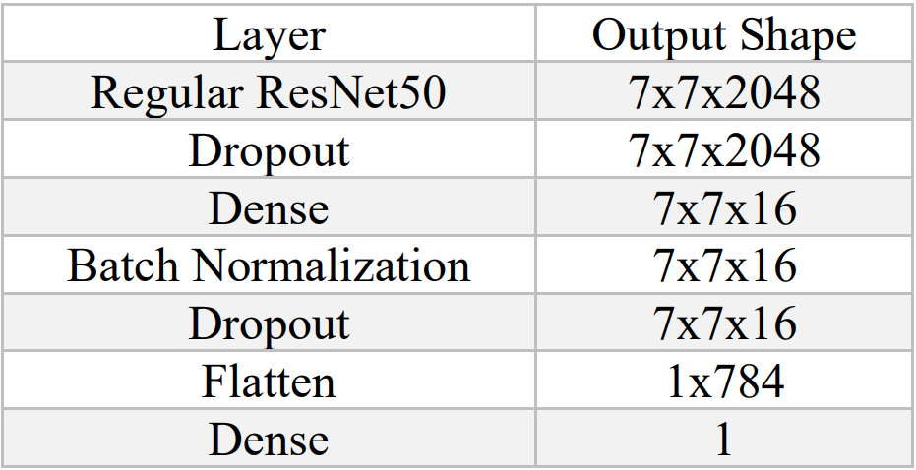
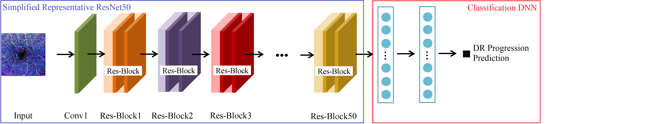
Image-based Neural Network
ResNet50 architecture used
DNN attached to end of ResNet50 model
Transfer learning with pre-trained weights
Optimizer “adam” used
Top-layer DNN
Notes:
For the image based approach, a ResNet50 model was used.
(note) ResNet was used because it is lighter weight, has quicker computation times, and works with large amounts of data since it does not suffer from the vanishing gradient problem (less worries of getting stuck with a zero gradient during back propagation)
The blue box outlines the portion of the network architecture with learning transferred from ImageNet and DR classification networks.
This section acts as the feature extraction portion of the architecture by freezing the weights of most of the ResNet50 architecture, only setting five convolutional layers in the latter blocks of the architecture to be trainable.
The red box outlines the classification portion of the architecture that takes the outputs of the pretrained, fine-tuned neural network and performs classification.
The attached neural network used for classification is based on 2 hidden layers with batch normalization and dropout.
For all tests, the adam optimizer was used.

Slide 14
Image-based Network: Results
Dataset composed of 237 images, with the smaller class containing 32 images.
Imbalance and size of dataset causing network to overfit to larger class
Best performing network:
Data augmentation
TL with ImageNet weights
Once more data is acquired, methods can be retested
More data should allow the network to generalize
Model (ResNet50 Architecture) | Val. Accuracy (%) | Specificity | Sensitivity
Benchmark network | 85.4 | 1 | 0
Transfer learning with ImageNet weights | 85.4 | 1 | 0
Transfer learning with DR class. weights | 85.4 | 1 | 0
Down-sampling dataset | 19.3 | 0.161 | 1
Weighted classes | 85.4 | 1 | 0
Data augmentation | 85.4 | 0.976 | 0.143
Notes:
The table on the right displays the results from each test. Nearly every network overfit to the larger class, similar to what was found with the feature-based approach
[*] The only tests that did not entirely overfit were the tests that combatted overfitting by balancing the datasets.
The network with the best performance used the MIP of segmentations as the third channel, data augmentation, and initialized with ImageNet weights.
The reason why the results were not ideal was because while 237 images is not a small dataset, only 13.5% of eyes converted, and all the methods that we employed to combat this imbalance were not successful

Slide 15
Conclusion
Transfer learning allowed image-based approach to outperform feature-based method
Both methods exceeded the DR progress prediction goal, but this was due to an imbalanced dataset
Goal: Accuracy greater than 75%
Accuracy may not be the best metric to use as a goal
Image-based methods had specificity values comparable to fundus-powered diagnostic tools reported in Literature^{3,4,5}
More data is required to produce a network for DR progression prediction
Model | Accuracy | Specificity | Sensitivity
No Progression/Progression Feature based NN | 85.4 | 1 | 0
ImageNet pretrained ResNet50 with data aug. | 85.4 | 0.976 | 0.143
DR severity classification NN using fundus images^{[6]} | N/A | 0.77 | 0.66
Notes:
The Image-based approach proved to be superior to the feature-based approach for the prediction of DR progression.
Due to the smaller size of the dataset, utilizing pre-trained weights for feature extraction and data augmentation allowed the image-based network to outperform the parameter-based network by not entirely overfitting to the larger class
The parameter-based and image-based methods both exceeded the goal of predicting the progression of DR with an accuracy greater than 75%, but this is largely due to the imbalance of the dataset, specifically the validation set.
Image based methods produced specificity values similar to those found in Literature, but sensitivity values were much lower for our tests. The group that trained a neural network for prediction of DR progression used a dataset of over 4000 images.
(note) 683 eyes, 4781 Colour fundus photos (7-field CFP’s, or 7 CFP’s per patient)
In conclusion, the results for the image-based approach are promising, but more data is required. More data will not only provide the network with more training data but will allow for an actual testing set to be made.

Slide 16
Acknowledgements
Prof. Marinko V. Sarunic
Valuable guidance and mentoring
Prof. Mirza Faisal Beg and Prof. Myeong Jin Ju
Excellent feedback
Mr. Timothy Yu, Mr. Julian Lo, Dr. Da Ma, and the Biomedical Optics Research Group (BORG) team members
Specifically Mr. Timothy Yu – Technical expertise and support
My Family and Friends
Love, patience, support, and encouragement
Notes:
I’d like to thank my thesis committee for the feedback and guidance for this project.
A big thanks to Professor Sarunic for mentoring me and for spending countless hours with me on this project.
I’d like to thank everyone at the BORG, especially Mr. Timothy Yu, Mr. Julian Lo, and Dr. Da Ma for guiding me from the start to end of this project, and constantly being there for my frequent barrage of questions.
Lastly, I’d like to thank all of my family and friends for their constant love and support.

Slide 17
Questions?
Notes:
A big thanks to everyone here listening to this presentation.

Slide 18
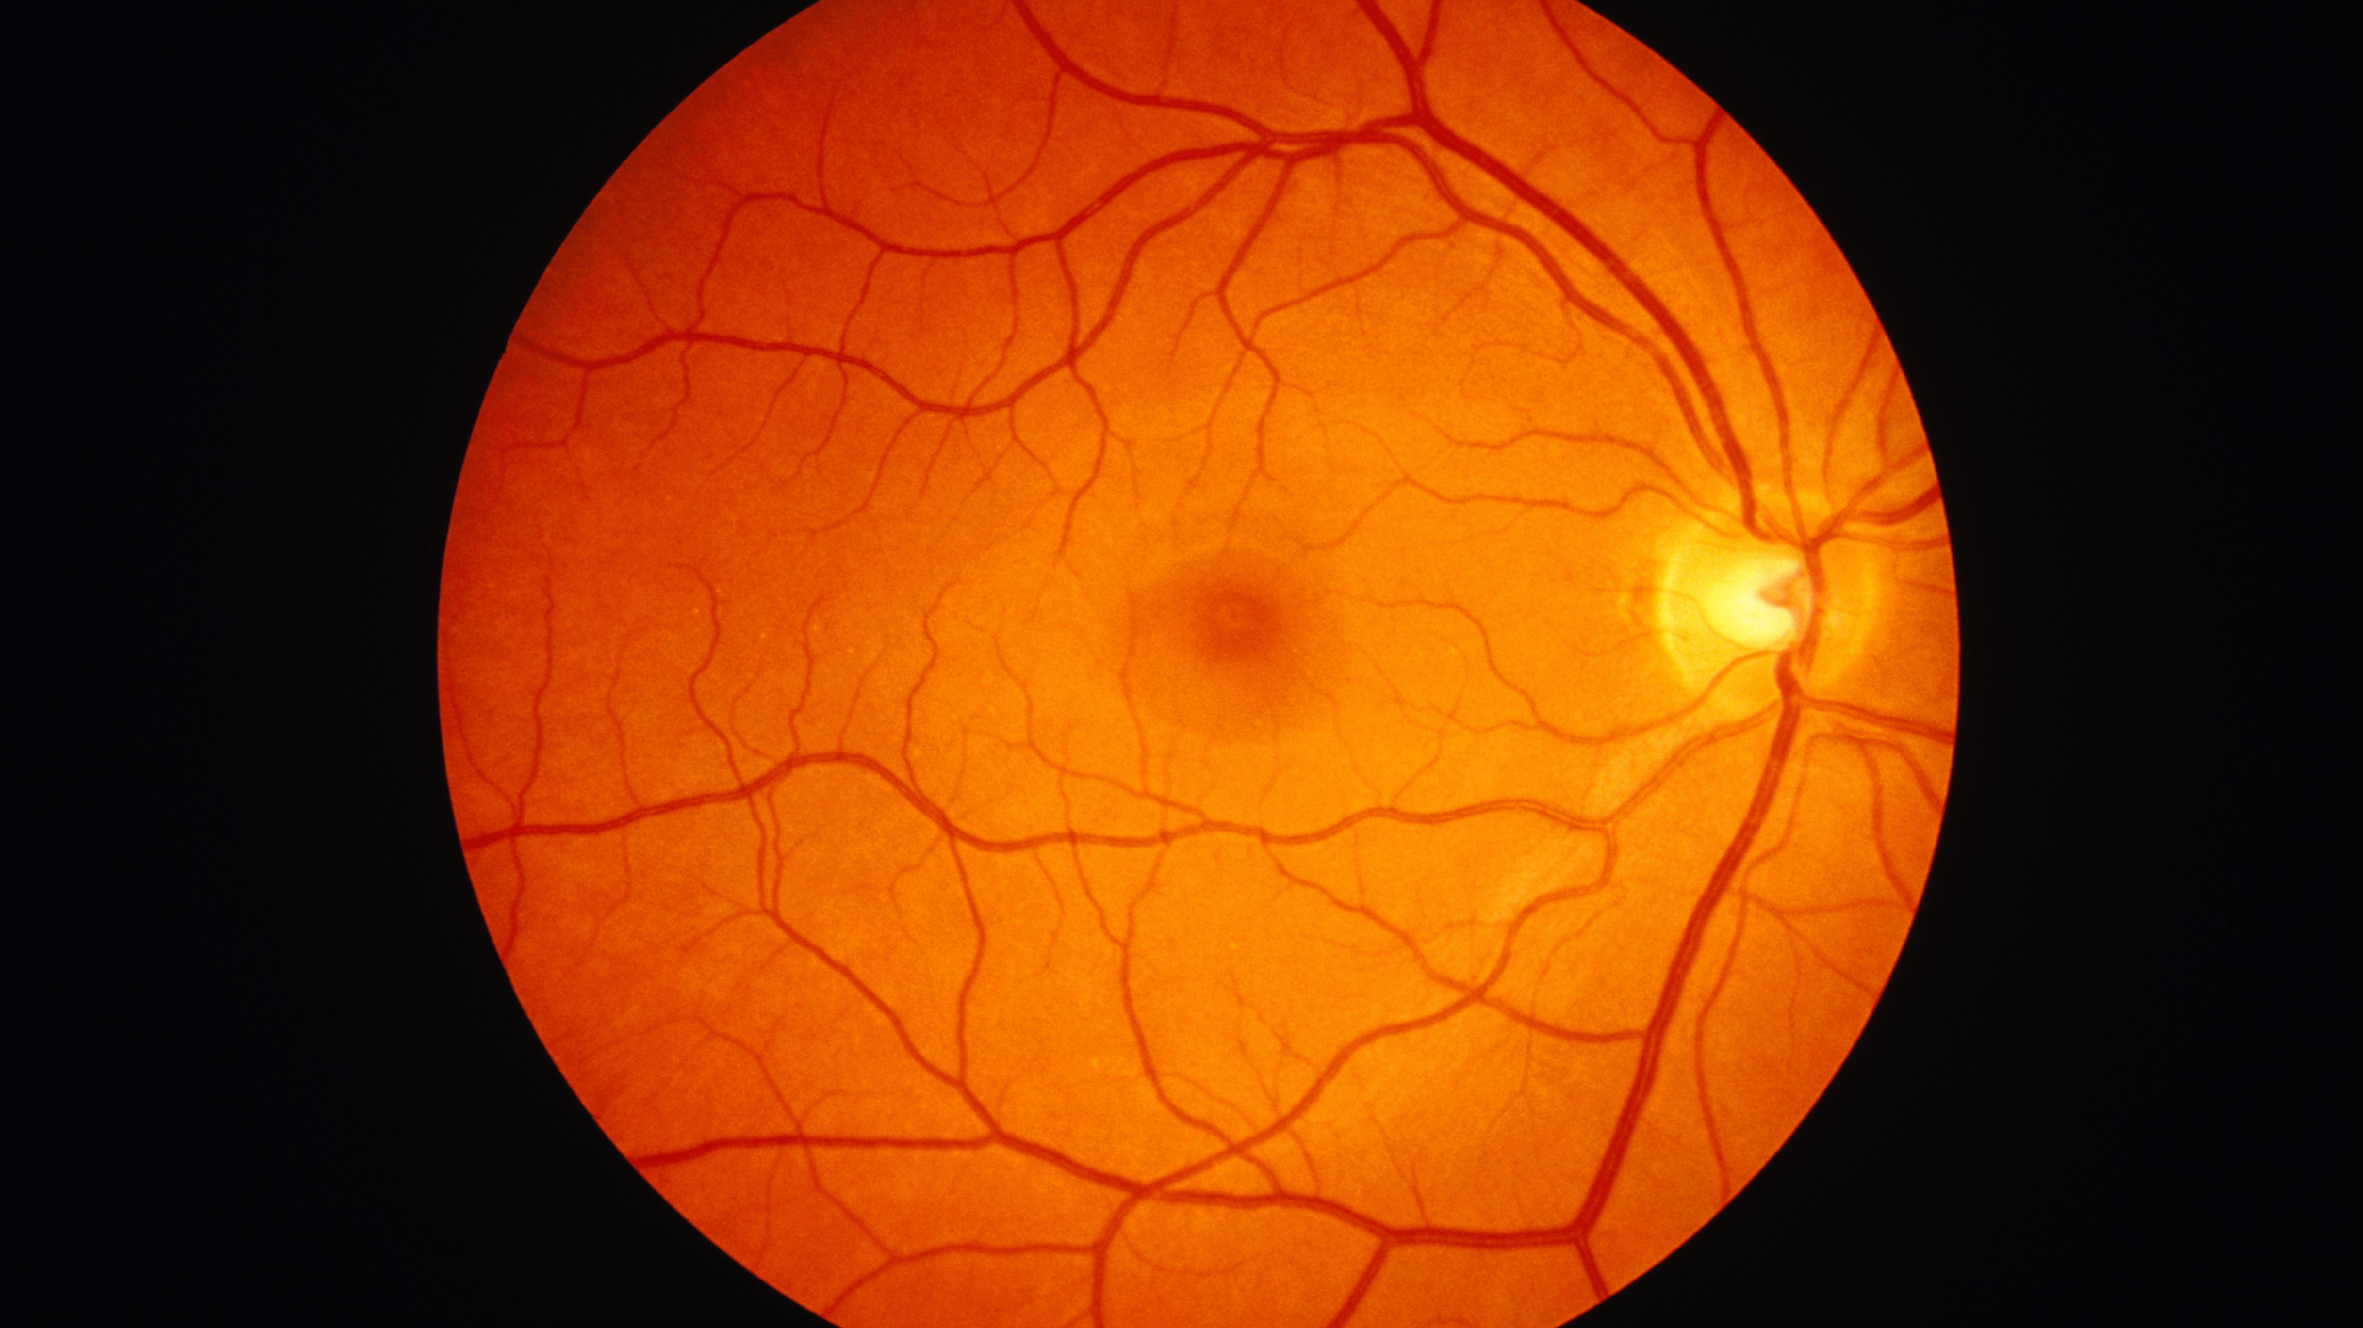
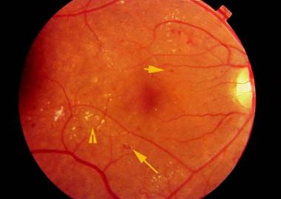
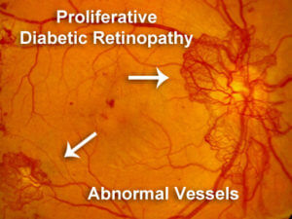
Diabetic Retinopathy
Pathophysiology
Glucose build-up -> microvascular lesions and retinal degeneration
Early stages (NPDR)
↑ vascular permeability and capillary occlusion
Microaneurysms, hemorrhages, and hard exudates
Advanced stages (PDR)
Neovascularization, vitreous hemorrhage, retinal detachment
Notes:
Thanks for the question, Marinko and I discussed adding this slide as it was not as relevant and we eventually decided to omit it due to the time limitation. The elevated glucose levels result in a build-up of glucose causing micro-vascular lesions and retinal degeneration. Patients with mild, moderate, or severe diabetic retinopathy are in the early stages of the disease. Pathophysiological changes include an increase in exchange between the blood and retinal tissues due to increased vascular permeability, as well as blocked capillaries due to the build-up of glucose.
In the advanced stages of diabetic retinopathy (termed as proliferative diabetic retinopathy, or PDR), there’s a formation of new blood vessels. These blood vessels are weaker and results in a further increased exchange between the blood and retinal tissues. Fluids may leak into regions and cause detachment of layers.

Slide 19
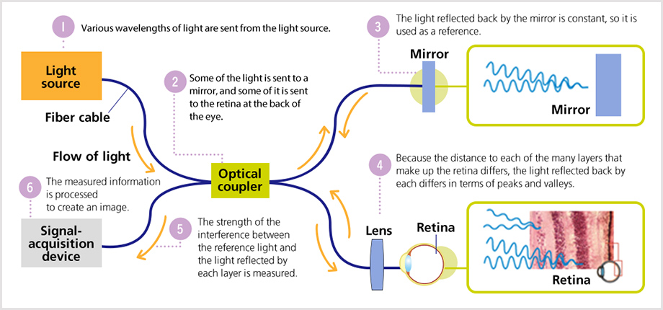
Optical Coherence Tomography
Notes:
Thank you for the question. OCT is a non invasive technology that enables mapping of layer thickness across the surface of the retina. A spot of light maps a reflective profile of the depth and as the scanner sweeps the position laterally across the surface of the retina, many A-scans are combined together to create a 2D cross sectional slice, termed as a B-Scan.
TD vs FD: TD is mechanically, FD is spectrometer based or swept source tunable laser.
Theory behind it: It uses broad wavelength range in the infrared spectrum allowing penetration into the retinal tissue where an optical splitter will divide the light to two paths. Some of the light will be directed to the tissue and acquires depth information through the backscattering boundaries of each layer. These backscattered lights will be compared to the reference mirror which is the other path of the optical splitter. This reference mirror is adjustable and by adjusting the reference mirror, the system adjusts the distance travelled by the light in the reference arm, allowing depth of the retinal layers to be measured.

Slide 20
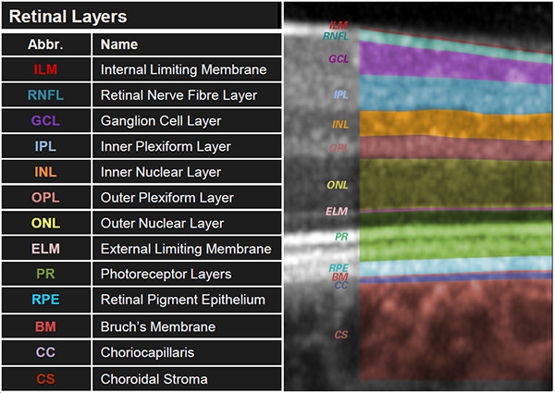
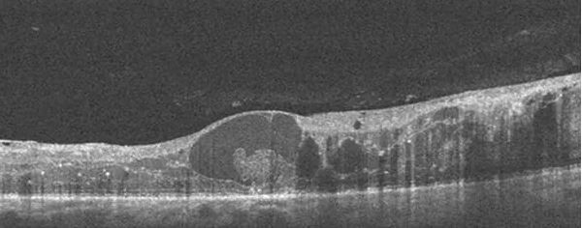
Optical Coherence Tomography

Slide 21
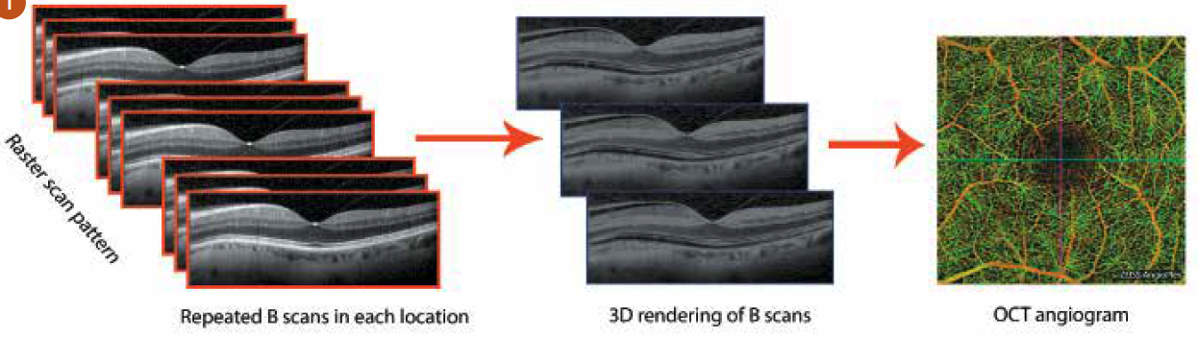
Optical Coherence Tomography
Notes:
OCTA is an extension of OCT that is acquired by comparing sequentially acquired B-scans at the same location on the retinal. By creating a volume of the repeated B scans, retinal blood flow can be visualized because the regions with changes (blood vessels) will have high variation between sequential B-scans which will yield high intensity pixels. Low intensity pixels will represent stationary tissues.
OCTA is viewed in the en face plane.

Slide 22
SCP and DCP Description
SCP: 2.6um below internal limiting membrane (ILM) to 15.6um below the junction between the inner plexiform layer (IPL) and the inner nuclear layers (INL)
DCP: 15.6um below IPL to 70.2um below the IPL
Notes:
The university of Hong Kong described the SCP to be ….

Slide 23
Breakdown of Data
Dataset
Final neural networks were trained, and validated on 237 eyes
Chinese University of Hong Kong
Swept Source Optical Coherence Tomography Angiography (DRI OCT Triton, Topcon Inc)
205 “No Progression” (164 training, 41 validation)
32 “Progression” (25 training, 7 validation)
Notes:
The data was acquired adhering to the helenski….

Slide 24
Contributions
Co-op at the BORG
Manual Segmentations for Julian Lo’s vessel segmentation network
DNN for retinal layer segmentation

Slide 25
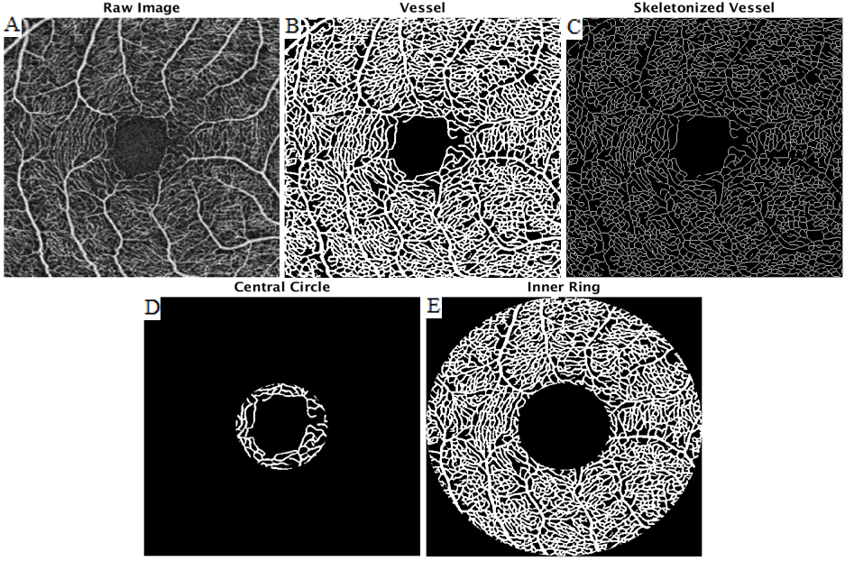
Vascular Parameters
The vascular extracted parameters included fractal dimension, skeletonized density, inner density, central density, total density, and average vessel diameter.
Processed images used for feature extraction: raw image (A), vessel segmentation (B), skeletonized image (C), 0-0.5mm radial mask (D), 0.5-1.5mm radial mask (E).

Slide 26
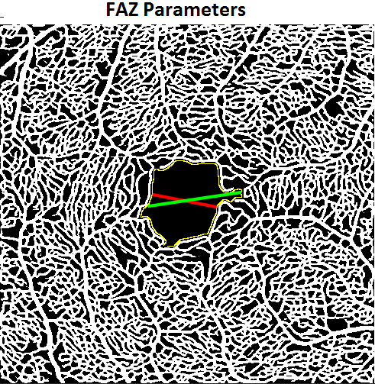
Avascular Parameters
The Figure shows the FAZ from which area, perimeter, maximum diameter, minimum diameter, axis ratio, acircularity index, and eccentricity were calculated.

Slide 27
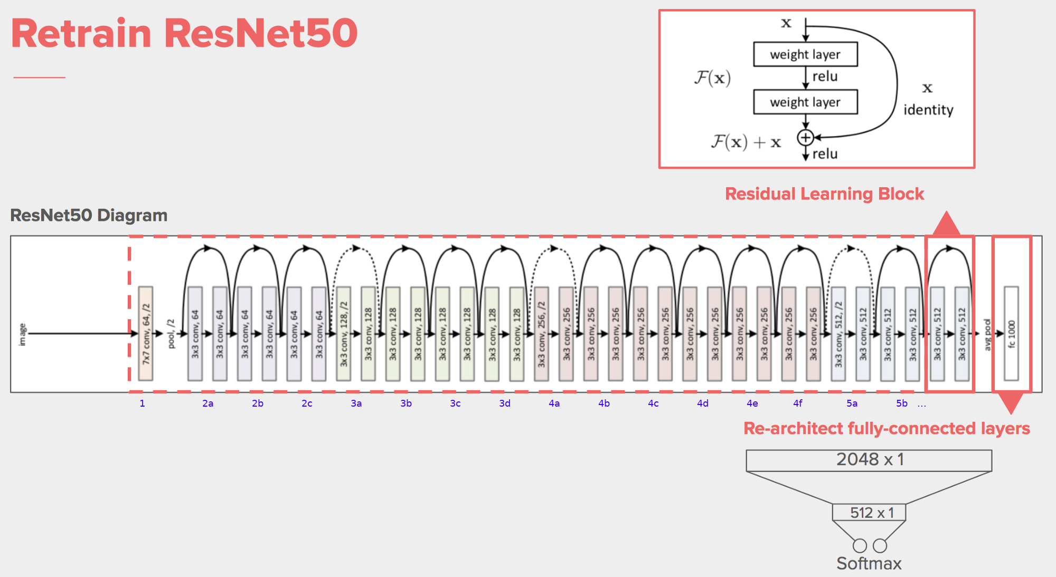
ResNet50 Architecture
Notes:
Same as this diagram, there are multiple residual blocks, each block with 2 convolutional layers
1 block with 32 channel filter
3 blocks with 64 filters
4 blocks with 128 filters
6 blocks with 256 filters
3 blocks with 512 filters
Total of 48 convolutional layers with 1 maxpool layer and 1 average pool layer (at the end)
WHY RESNET?
with deeper networks, as the gradient keeps flowing backwards to the initial layers, (the gradient value keeps getting multiplied by the local gradient) resulting in a gradient that becomes smaller and smaller, which makes the updates to the initial layers very small, increasing training time considerably. The skip connections between the residual blocks act as gradient “highways”, allowing for the gradient to flow unhindered.

Slide 28
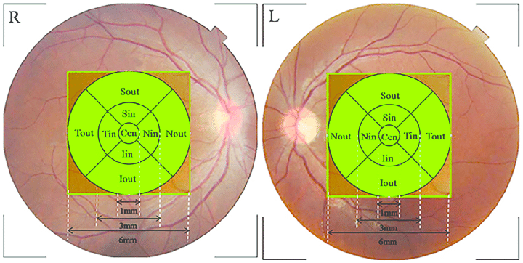
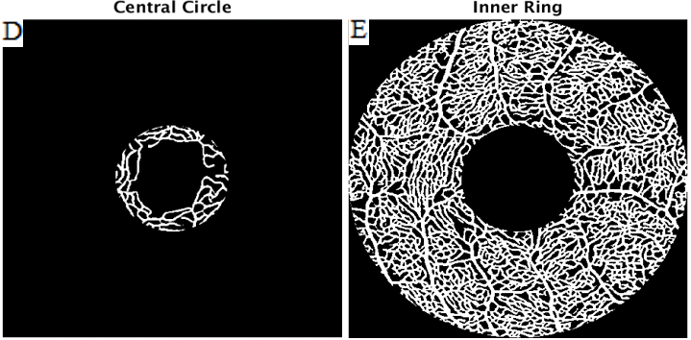
Extracted Parameters Correlated to DR Prog.
Fractal Dimension (Cen)
Fractal Dimension (Tin)
Fractal Dimension (Sin)
Fractal Dimension (Full Image)
Max FAZ Diameter
FAZ Area
FAZ Perimeter
Early Treatment Diabetic Retinopathy Study

Slide 29
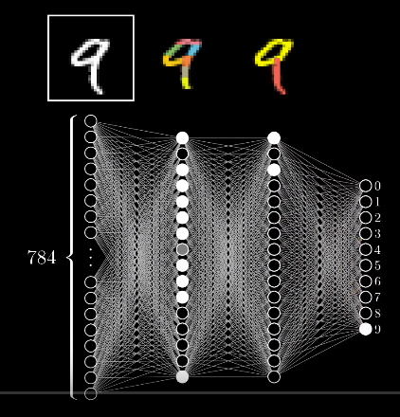
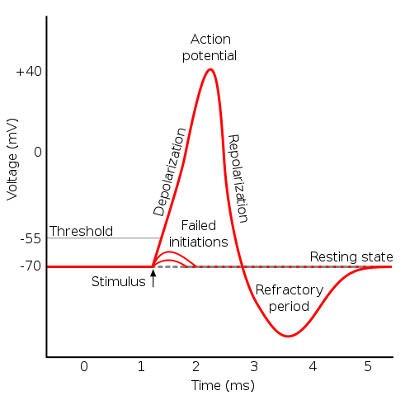
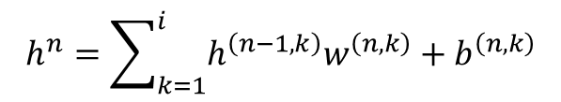
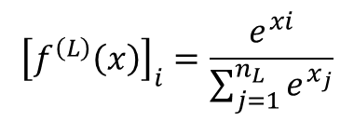
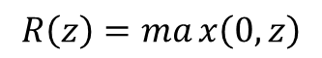
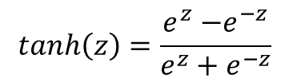
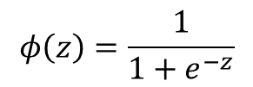
Neural Network
Fully-connected layers being updated. Preceding layer (h), weights (w), bias (b)
$$h^{n}=\sum_{k=1}^{i}{h^{\left(n−1,k\right)}w^{\left(n,k\right)}+b^{\left(n,k\right)}}$$
Activation functions (node fire or not)
$$tanh\left(z\right)=\frac{e^{z}{−e}^{−z}}{e^{z}+e^{−z}}$$
$$R\left(z\right)=max\left(0,z\right)$$
$$φ\left(z\right)=\frac{1}{1+e^{−z}}$$
$${\left[f^{\left(L\right)}\left(x\right)\right]}_{i}=\frac{e^{xi}}{\sum_{j=1}^{n_{L}}{e^{x_{j}}}}$$

Slide 30
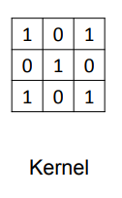
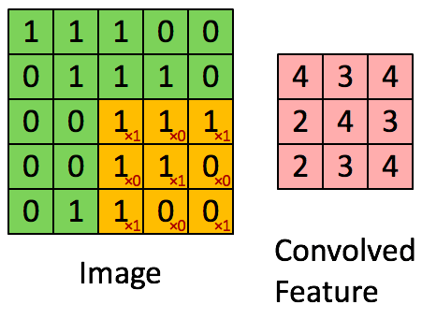
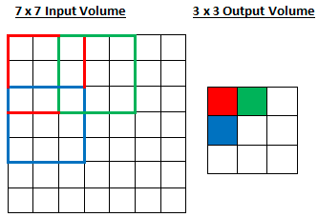
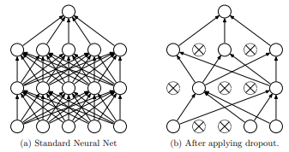
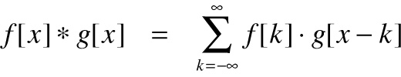
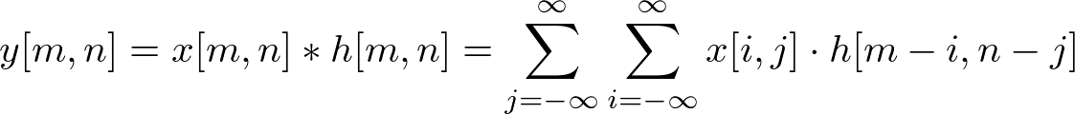
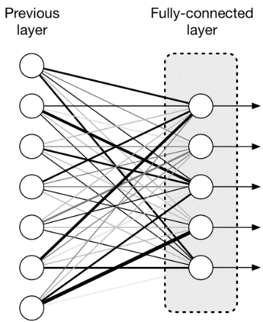
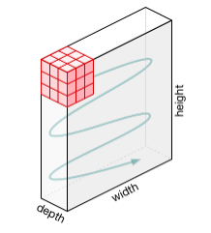
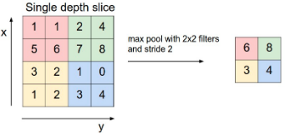
Convolutional Neural Network Elements

Slide 31
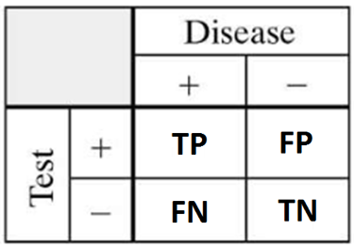
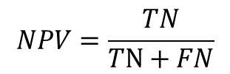




Classification Performance Metrics
$$PPV=\frac{TP}{TP+FP}$$
$$NPV=\frac{TN}{TN+FN}$$
$$Sensitivity=\frac{TP}{TP+FN}$$
$$Specificity=\frac{TN}{TN+FP}$$
$$DA=\frac{TP+TN}{TP+FP+FN+TN}$$
Notes:
Positive predictive values
Negative predictive values

Slide 32

AI, machine & deep learning
Artificial intelligence (AI) is very broad and encompasses anything that learns and thinks like a human being.
In AI, a Turing Test is used to determine whether or not a computer is capable of thinking like a human being; to a point where someone can have a conversation with it and can’t tell if it’s a human or an AI.

Slide 33

What is machine learning?
There are three different types of machine learning
Supervised Learning
The images will be the input data, and their expected outputs will be the input labels
Data and labels (targets) available for training
Example: normal, NPDR, PDR classification
Reinforcement learning (semi-supervised)
Some information about good vs bad outputs available, but not explicit label or targets
Example: game playing (chess, backgammon, ..)
Unsupervised learning
No information about intended outputs
Data exploration (finding patterns tendencies…)
Example: clustering

Slide 34



Typical machine learning problems
There are three different types of machine learning
Classification
Reading numbers
Normal, NPDR, and PDR
Regression
Model (eg. Polynomial fitting)
Structured output
Generate data-like, complex outputs
Examples: Layer segmentation, fluid segmentation

Slide 35

Classification
Classifiers can be used to classify anything from the severity of DR, to whether a picture is a Chihuahua or a muffin
In supervised learning, we give the machine images that have been pre-classified and by knowing what the image should output, the machine will adjust it’s weights depending on what combination results in the most accurate output
Machines can be binary classifiers (eg.
normal and DR), categorical classifiers (eg.
normal, NPDR, and PDR), or multiclass classifiers
(eg. A machine picks out a water bottle, mug, and
flower from 1 image)

Slide 36

Neural signals
Input signals received at dendrites, through summation, may cause the neuron to fire if the potential reaches the threshold voltage
In the same token, machine learning uses nodes to act as neurons that fires depending on whether the total input surpasses the weights/threshold of the neuron
These weights are adjusted by repetitive “training” and having the machine try to find the best combination

Slide 37

Neural Network & DNN
DNN: deep neural network (neural network with multiple layers)
CNN: convolutional neural network (a type of deep neural network used in computer vision, acoustic modeling, automatic speech recognition)
RNN: recurrent neural network in which data can flow in any direction; used for (eg. Language modeling)

Slide 38

Epoch
One epoch is when the entire data set is passed through the neural network once
Think of each epoch as learning something once through; when you are trying to learn something new, each time you review all your notes, you will pick up new facts, relearn some new topics
We train and try to find the optimal number of times we feed the data into the machine (#/epochs)
Feeding in too many epochs may overfit a system, whereas too little may underfit

Slide 39

Overfitting & Underfitting
Case: Imagine giving a child cards with pictures of animals
Overfitting would be if the child sees the same cards over and over again, all the dogs just happened to be black, and whenever the child sees something black, they think it’s a dog
Underfitting would be if most of the cards are cats, in order to get the most correct, the child will just always guess cats

Slide 40
Limitations
Hardware
Comparison between methods
Size of dataset (427 OCTA en face images)
In comparison, the fundus dataset used in Literature contained upwards of 35,000 labelled images

Slide 41
Future Work
Improve hardware
Increase the number of labelled data or implement semi-supervised learning
Transfer learning from retinal medical images (i.e. fundus)
Improve OCT retinal layer segmentation and utilize properly segmented layers

Slide 42
Data Augmentation Used
Dropout 5-10% of all pixels
Linear contrast shift of 0.9 to 1.1 (either pronounce or dampen values compared to dtype center of 127)
Rotations of maximum 10 degrees either direction
Vertical and Horizontal flips

Slide 43
ResNet Residual Blocks

